Slide 1
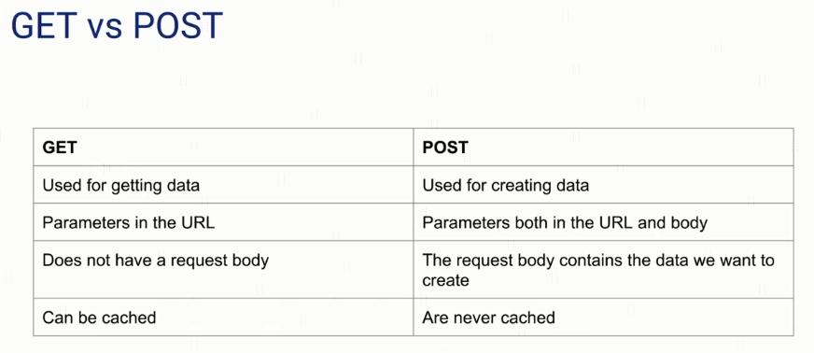
GET vs POST & What is a Cache?

Slide 2


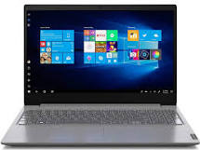
GET vs POST & What is a Cache?
Client 1
Get List Of Cars
Client 2
Get List Of Cars

Slide 3

GET vs POST & What is a Cache?
Client 1
Main Server
Cache Server
Get List Of Cars
Get List Of Cars
Client 2
Get List Of Cars

